Slide 1

E-Waste Data Analysis for Optimizing Resource Efficiency
Natalie Celt, Paul Cao, Daniel Molina, Carolina Rios-Martinez

Slide 2

What is E-Waste?

Slide 3

11,700,000 tons
of e-waste is produced by the United States annually¹

Slide 4


E-Waste Management Methods
Domestic Method:
Hire external company to facilitate proper disposal
Very costly
Foreign Method:
Export e-waste to foreign countries (underdeveloped)
Cost-effective
“10 times cheaper to export e-waste to developing countries than it is to locally recycle”²
Environmentally unfavorable

Slide 5

Harm of Chemical Exposures
Human Health:
Exposure to toxic components:³
Lead
Mercury
Cadmium
Can lead to:³
Birth defects, brain, heart, liver, kidney, skeletal damage
Environment:
Toxins seep into water and soil
Pollution from burning

Slide 6


Our
Technology
Alignment, void detection, volume sensing light curtain
AI Commons Python Library
Collection of Arraylists
https://github.com/DanielMolina24/TeamK.git

Slide 7
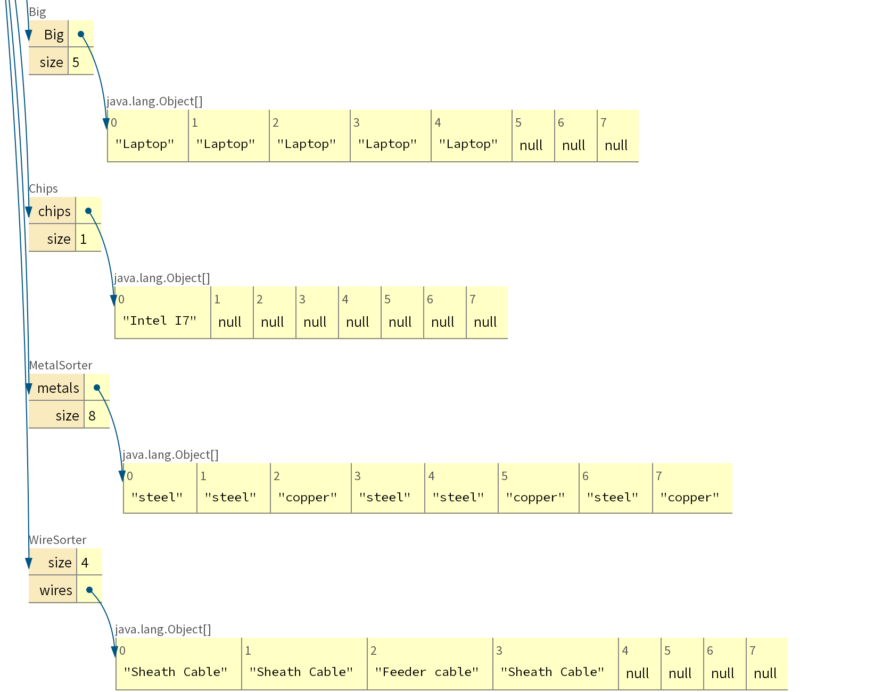
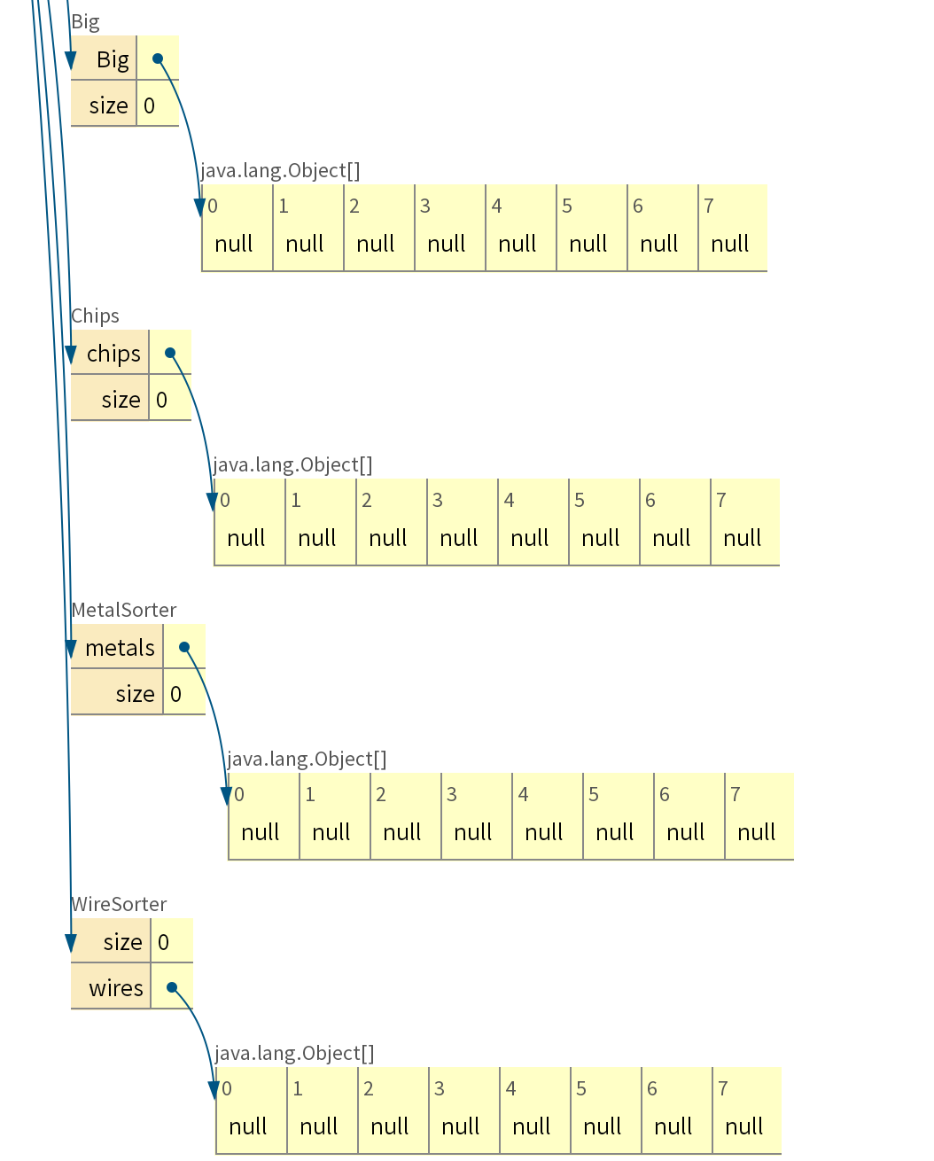
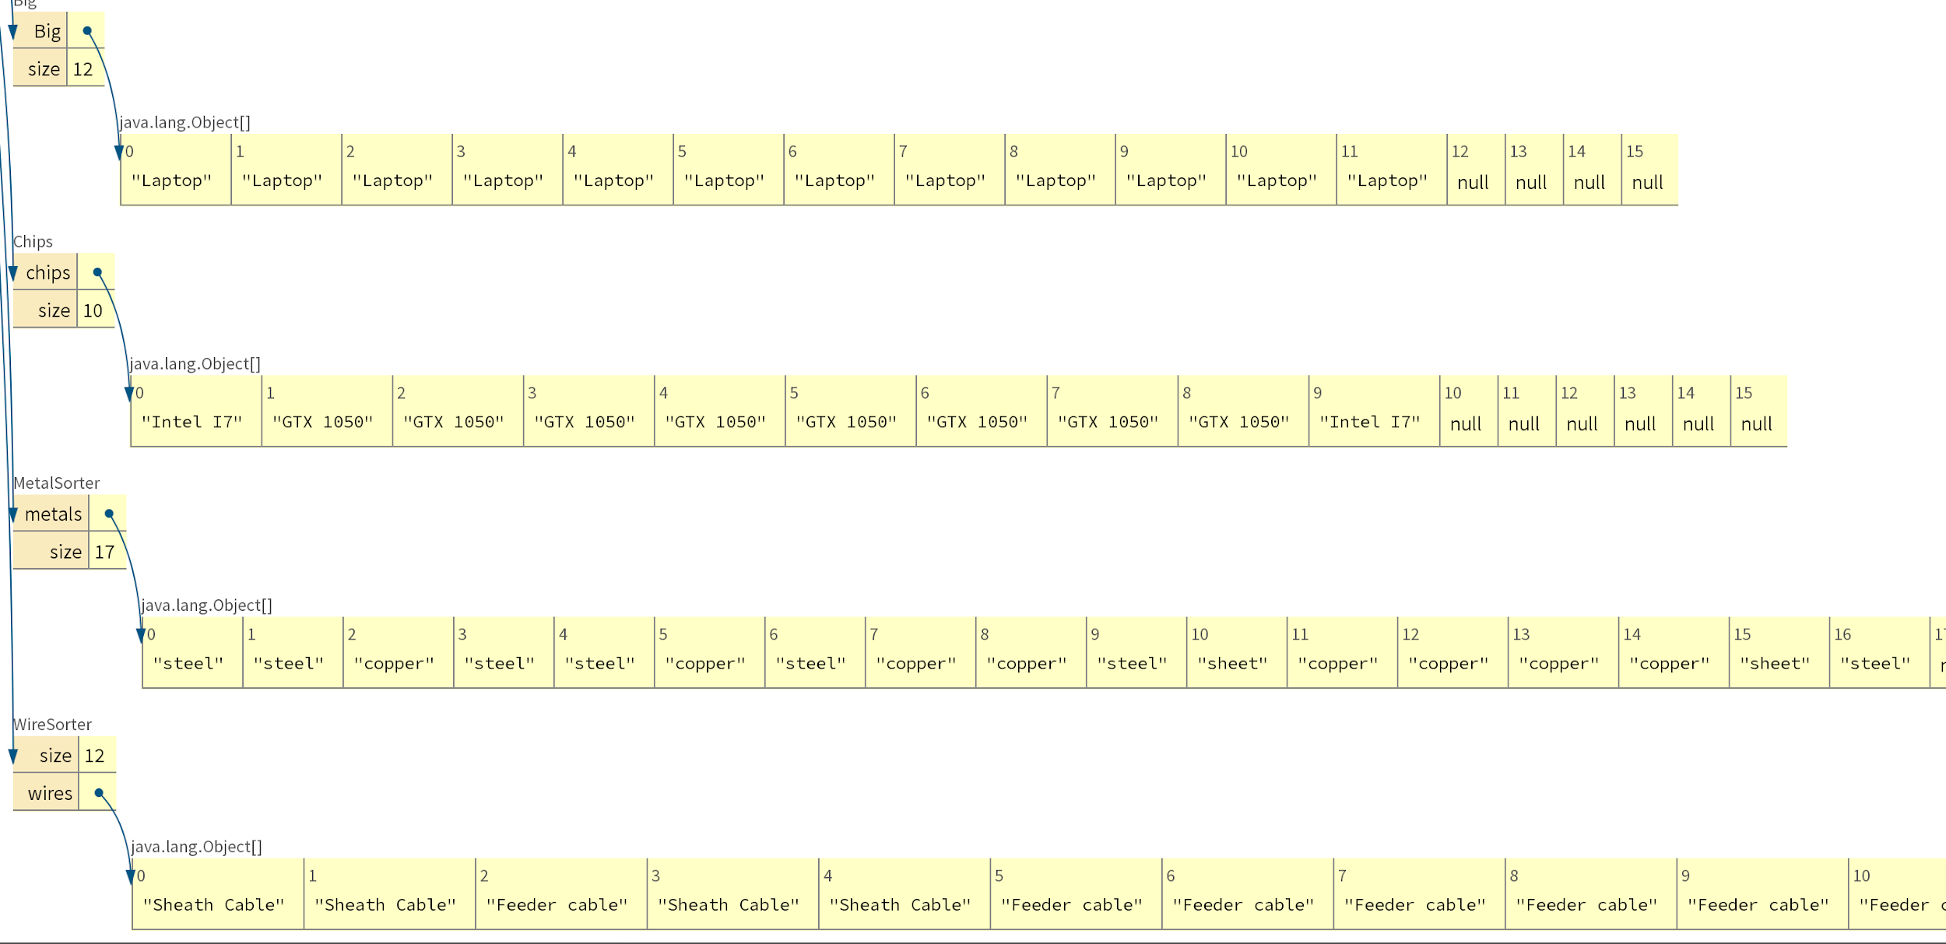
Array Lists
2.
1.
3.

Slide 8
References
LeBlanc, Rick. “Here Is a Look at E-Waste Recycling Facts and Figures.” The Balance Small Business, The Balance Small Business, www.thebalancesmb.com/e-waste-recycling-facts-and-figures-2878189.
Vos, Sophie. “Electronic Waste Disposal.” Lori Bennear Research Group, Nov. 2012, sites.nicholas.duke.edu/loribennear/2012/11/15/electronic-waste-disposal/.
Grant, K., Goldizen, F. C., Sly, P. D., Brune, M. N., Neira, M., van den Berg, M., & Norman, R. E. (2013). Health consequences of exposure to e-waste: a systematic review. The lancet global health, 1(6), e350-e361.
Caravanos, J., Clark, E., Fuller, R., & Lambertson, C. (2011). Assessing worker and environmental chemical exposure risks at an e-waste recycling and disposal site in Accra, Ghana. Journal of health and pollution, 1(1), 16-25.

